Slide 1
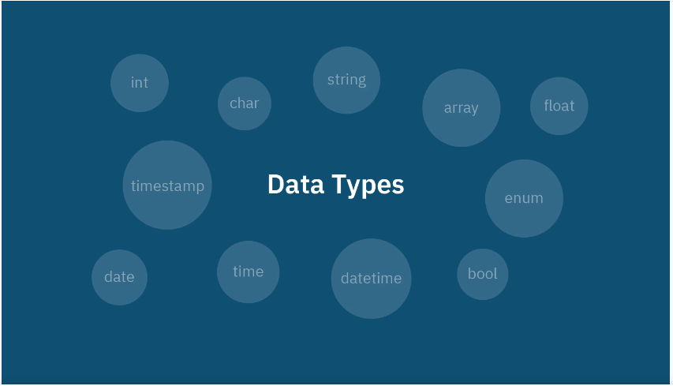
Notes:
Date and time data types include the following:
•Date(YYYY-MM-DD) data types(datetime -YYYY-MM-DD hh:mm:ss )
•Time data types
•Timestamp data types(date, time)
•Interval data types(an interval year to month ,day to minutes)

Slide 2
Data types
Build-in Data types
Derived Data types
User-defined Data types

Slide 3
Build-in data types
Pre-defined by the programming languages.
Can be directly used to declare and store different variables in a program.
Called “Primitive data types”.

Slide 4
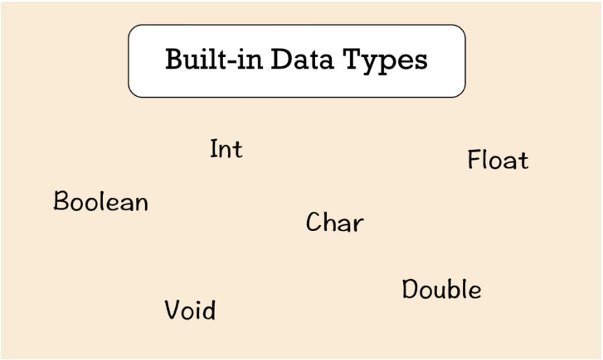

Slide 5
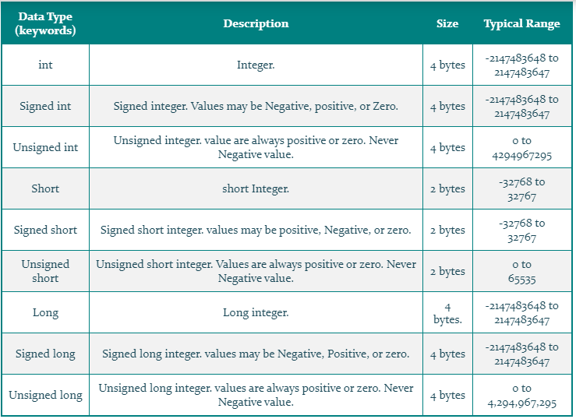
Integer data types(int)

Slide 6
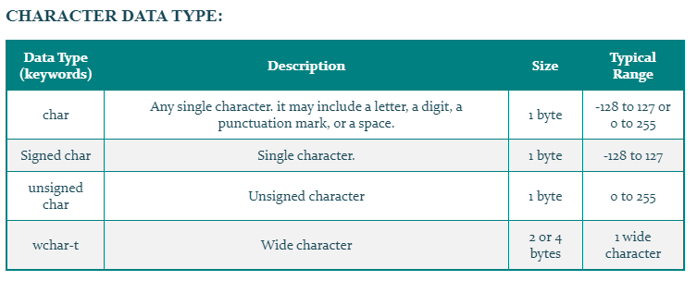
Character data types(char)

Slide 7
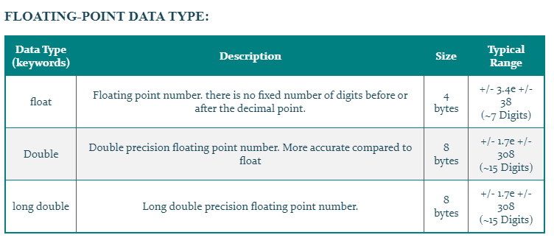
Floating-point Data Types:

Slide 8
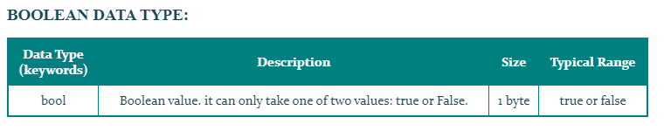
Boolean data type:
Void data types
-widely used in programming languages.
-mainly used return types for function(not return value) eg. void message(){}

Slide 9
User-defined data types
Data types whose variable hold more than one value dissimilar data types.
The following data types are user-defined data types-
1.Structure
2.Union
3.Class
4.Enumeration

Slide 10
Structure
-A way to group similar or dissimilar data types refers to by a single name.
Struct(keywords)
Name={1,’c’,12.5,”xyz”}
Declaring structure variables
-(struct , structure tag name, list of variable name,;)
Union
-Like structure except union members share same memory location.
union(keywords)
Declare( union, name, list variable,;)
Notes:
Example-
Struct name{
Int a;
Char b;
};
a’s address=632
b’s address=635
union
Example-
union name{
int a;
char b;
};
a’s address=635
- b’s address=635

Slide 11
Class
Enumeration
class(keywords)
Data member, member function
Member function(manipulate data, create and destroy class variable)
enum(keywords)
-finite set of enumeration constants
Notes:
class{
Private string name=“Hla”;
Private int age=20;
Public void main(){
c.wl({0}+”is”+{1}+”years old”,name,age);
}
}

Slide 12
Derived data types
Are derived by build-in data types
-Array
-Function
-references
-pointer

Slide 13
Array
-set of element same data types
-can store fixed numbers of elements in memory
Eg, int i={1,2,3,4,5}
Function
-self contained program segment
-may have one or more function in program.
Pointer(*)
-can store memory of another variable.
-allow to use memory dynamically.
-with help of pointer, memory can be allocated or de-allocated to the variables at run-time.
Reference(&)
-alternative name for variable in programs.
Notes:
function
1.Return value, access data(parameter)
2.Return value, not access data
3.Not return value, access data
4.Not return value, not access data
(return-type fun-name(parameter list))

Slide 14

Thank you Question & Answer

